Slide 1



Chicago CRIMES
BLACK BELTS TEAM

Slide 2
TABLE OF CONTENTS
01.
02.
03.
INTRODUCTION
VISUALIZATION
PIG
04.
05.
06.
SPARK
KAFKA
CONCLUSION
Objective and data description
EDAs and Dashboard
Processing and querying
Classification
Building real-time streaming data pipeline
Finding and suggestions

Slide 3
01.
INTRODUCTION
Objective and data description

Slide 4

SAUDI VISION 2030!
The Kingdom's cities are among the safest cities in the world. Its crime rate is just 0.8 per 100,000 residents per year, compared to a global average of 6.7.
The Kingdom will always work to maintain this safety through:
Strengthening existing efforts in the fight against drugs.
Adopt additional measures to ensure traffic safety and reduce road accidents.
Work to activate the digital police to combat crimes in the Kingdom.

Slide 5
Our Objectives
Determine the most common types of crimes and whether the convicts were arrested or not?
Determine the most places and times in which crimes occur?

Slide 6
Chicago Crimes Dataset…
This dataset reflects reported incidents of crime (with the exception of murders where data exists for each victim) that occurred in the City of Chicago from 2001 to present April 2022.
Data is extracted from the Chicago Police Department's CLEAR (Citizen Law Enforcement Analysis and Reporting) system.

Slide 7
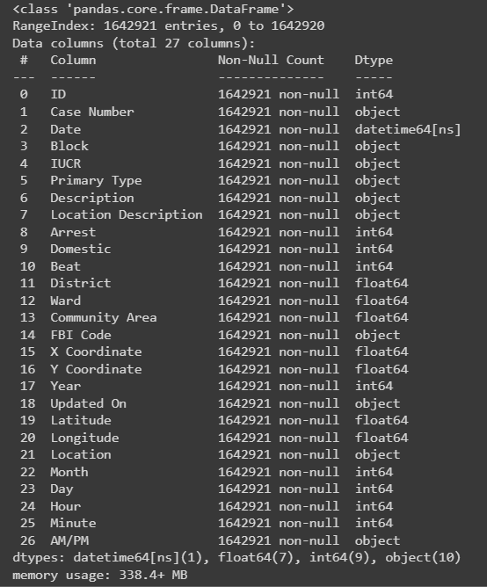
Data Description
Data were collected from 2001 to 2022, each year in a separate file, we took 2016 - 2022.
number of entries after removing null value 1642921
number of columns after extracting some columns from another one is 27
The data contained some information such as:
INDEXER: ID.
IDENTIFIER: Case Number, IUCR and FBI Code.
DESCRIPTION: Primary Type, Description, Location Description,
Arrest, Domestic.
DATE AND TIME: Date and Updated On, year, month, day, hour,
minute and AM/PM.
LOCATIONS: Block, Ward, Community Area, X and Y Coordinate,
Location, Longitude and Latitude, Beat and District.

Slide 8
02.
VISUALIZATION
EDAs and Dashboard

Slide 9
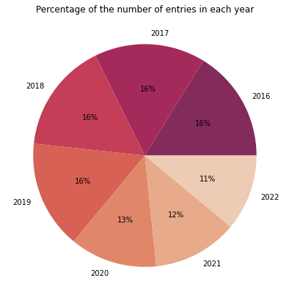
Percentage of the number of entries in each year

Slide 10
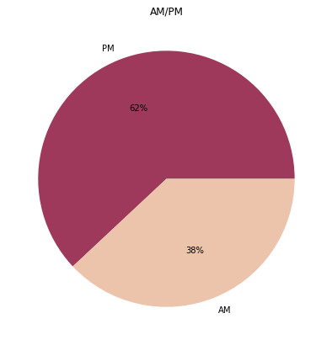
Data distribution ratio in the day and night.

Slide 11
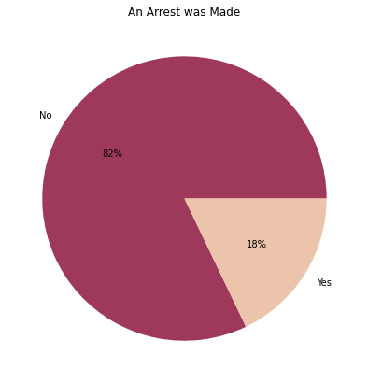
Crimes for which the convicts have been arrested

Slide 12

Domestic crimes under the Illinois Domestic Violence Act

Slide 13
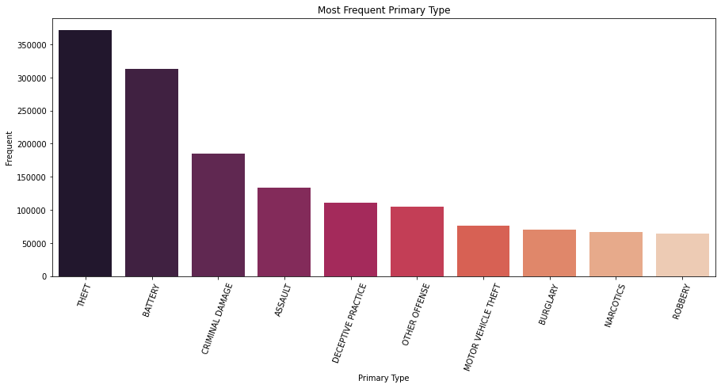
The Most Frequent Primary Type

Slide 14
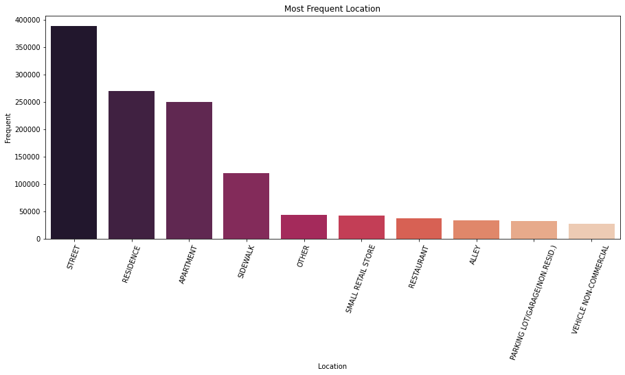
The Most Frequent Location

Slide 15
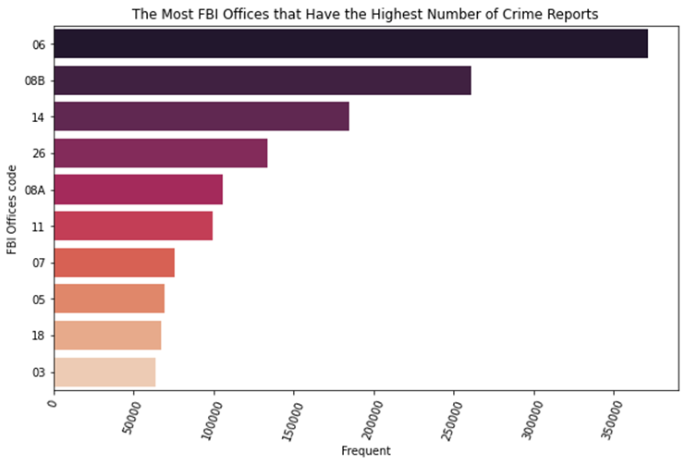
The Most FBI Offices that Have the Highest Number of Crime Reports

Slide 16
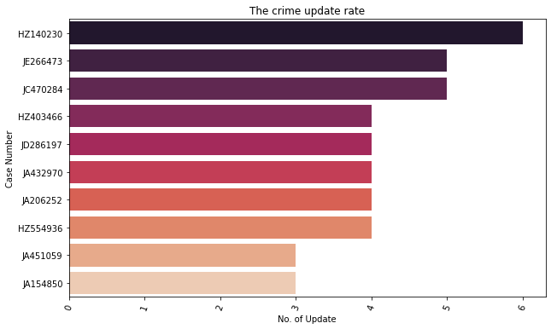
The crimes and its update rate

Slide 17
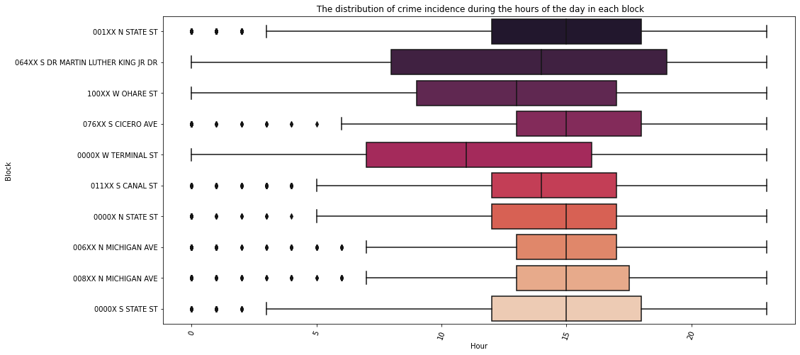
The distribution of crime incidence during the hours of the day in each block.

Slide 18
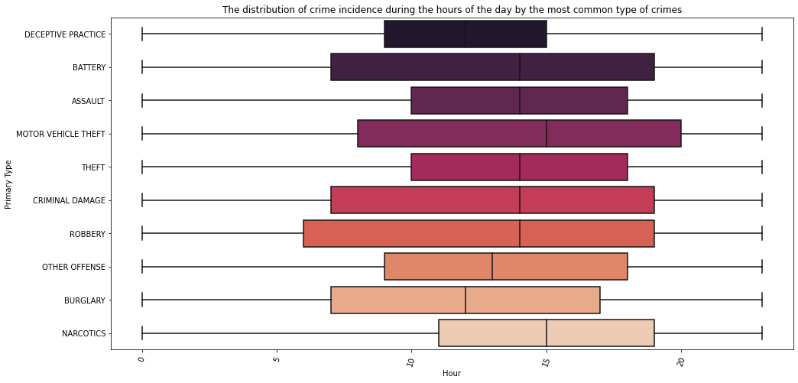
The distribution of crime incidence during the hours of the day.

Slide 19

DASHBOARD
Visual insight from dataset

Slide 20
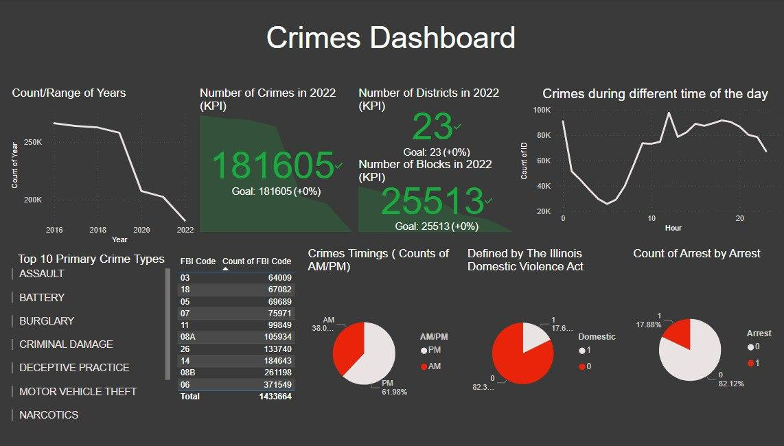

Slide 21
03.
PIG
Processing and Querying

Slide 22
Read data
data = LOAD 'path/Data.csv' USING org.apache.pig.piggybank.storage.CSVExcelStorage(',') AS(ID:chararray,Case_Number:chararray,Date:chararray,
Block:chararray,IUCR:chararray,Primary_Type:chararray,Description:chararray,Location_Description:chararray,Arrest:int,Domestic:int,Beat:int,
District:int,Ward:int,Community_Area:int,FBI_Code:chararray,X:long,Y:long,Year:int,Updated_On:chararray,Latitude:double,Longitude:double,
Location:chararray,Month:int,Day:int,Hour:int,Minute:int,AM_PM:chararray);

Slide 23
Q#1: how many crimes?
Output
grp = GROUP data All;
cnt = FOREACH grp GENERATE COUNT(data) ;
STORE cnt INTO 'path/pig_Output/Q1CrimesCount' USING PigStorage (',');
dump cnt;
1642922

Slide 24
Q#2: what the total number of unique ward in each block?
Output
rel1 = FOREACH data generate Block, Ward;
grp = GROUP rel1 By Block;
cnt = FOREACH grp
{
unique_ward = DISTINCT cnt1.Ward;
generate group, COUNT(unique_ward) as total_unique_ward;
};
ordered = Order cnt BY total_unique_ward DESC;
STORE ordered INTO 'path/pig_Output/Q17UniqueWardsInEachBlock' USING PigStorage (',');
dump ordered;
043XX W NORTH AVE,5
040XX W GRAND AVE,4
007XX S ASHLAND AVE,4
016XX N LOWELL AVE,4
002XX S RACINE AVE,4
043XX W GRAND AVE,4
001XX W SCHILLER ST,4
007XX S DAMEN AVE,4
020XX W POLK ST,4
021XX W HARRISON ST,4
006XX S ASHLAND AVE,4
001XX W MAPLE ST,4
.
.
.

Slide 25
Q#3: what are the months with the most crimes rates?
Output
grp = GROUP data By Month;
cnt = FOREACH grp GENERATE group AS Month, COUNT(data) As countPerMonth;
ordered= ORDER cnt BY countPerMonth DESC;
STORE ordered INTO 'path/pig_Output/ Q3CrimePerMonth' USING PigStorage (',');
dump ordered;
7,158265
8,157368
6,150569
5,148756
9,148359
10,137171
3,133252
1,132359
4,129495
2,118545
11,115043
12,113739

Slide 26
Q#4: what oldest and most recent crime committed?
Output
grp = GROUP data All;
yearsminmax = FOREACH grp GENERATE MIN(data.Year) As minYear, MAX(data.Year) As maxYear;
STORE yearsminmax INTO 'path/pig_Output/Q2dataYearRange' USING PigStorage (',');
dump yearsminmax;
2016,2022

Slide 27
Q#5: what are the most common crimes?
Output
grp = GROUP data By Primary_Type;
cnt = FOREACH grp GENERATE group As Crime, COUNT(data) As Crime_Rate;
ordered= ORDER cnt BY Crime_Rate DESC;
STORE ordered INTO 'path/pig_Output/ Q6MostCommonCrimes' USING PigStorage (',');
dump ordered;
THEFT,371549
BATTERY,313165
CRIMINAL DAMAGE,184643
ASSAULT,133935
DECEPTIVE PRACTICE,110662
OTHER OFFENSE,105413
MOTOR VEHICLE THEFT,75971
BURGLARY,69689
NARCOTICS,67069
ROBBERY,64009
WEAPONS VIOLATION,44479
CRIMINAL TRESPASS,37653
OFFENSE INVOLVING CHILDREN,14111
PUBLIC PEACE VIOLATION,8408
SEX OFFENSE,7104
INTERFERENCE WITH PUBLIC OFFICER,6163
CRIM SEXUAL ASSAULT,5186
CRIMINAL SEXUAL ASSAULT,4758
.
.
.

Slide 28
Q#6: what are the most common crimes per Year?
Output
grp = GROUP data By (Year, Primary_Type);
freq = Foreach grp generate FLATTEN(group) as (Year, Primary_Type) , COUNT(data) as frequency;
ordered = ORDER freq BY Year DESC, frequency DESC;
STORE ordered INTO 'path/pig_Output/Q7CrimeFreqPerYear' USING PigStorage (',');
dump ordered;
2022,THEFT,41749
2022,BATTERY,32870
…
2021,BATTERY,40314
2021,THEFT,39258
…
2020,BATTERY,41411
2020,THEFT,40223
…
2019,THEFT,61675
2019,BATTERY,49472
…
2018,THEFT,64024
2018,BATTERY,49713
…
2017,THEFT,63583
2017,BATTERY,49139
…
2016,THEFT,61037
2016,BATTERY,50246
…

Slide 29
Q#7: what are the most common crimes that result in arrests?
Output
filtered =FILTER data BY Arrest==1 ;
grp = GROUP filtered By Primary_Type;
cnt = FOREACH grp GENERATE group AS Crime, COUNT(filtered) As Arrest_Rate;
ordered= ORDER cnt BY Arrest_Rate DESC;
STORE ordered INTO 'path/pig_Output/ Q5ArrestCrimes' USING PigStorage (',');
dump ordered;
NARCOTICS,66773
BATTERY,58213
THEFT,31218
WEAPONS VIOLATION,29752
ASSAULT,19776
OTHER OFFENSE,19342
CRIMINAL TRESPASS,19020
CRIMINAL DAMAGE,9533
INTERFERENCE WITH PUBLIC OFFICER,5809
PUBLIC PEACE VIOLATION,4984
ROBBERY,4763
MOTOR VEHICLE THEFT,4270
DECEPTIVE PRACTICE,4167
PROSTITUTION,3539
BURGLARY,3493
.
.
.

Slide 30
Q#8: what are the most common domestic abuses?
Output
filtered =FILTER data BY Domestic==1 ;
grp = GROUP filtered By Primary_Type;
cnt = FOREACH grp GENERATE group As Crime, COUNT(filtered) As Domstic_offense_Rate;
ordered= ORDER cnt BY Domstic_offense_Rate DESC;
STORE ordered INTO 'path/pig_Output/ Q4DomesticAbuses' USING PigStorage (',');
dump ordered;
BATTERY,158341
OTHER OFFENSE,35738
ASSAULT,35717
CRIMINAL DAMAGE,24105
THEFT,15986
OFFENSE INVOLVING CHILDREN,8001
CRIMINAL TRESPASS,2241
BURGLARY,1402
ROBBERY,1267
SEX OFFENSE,1208
MOTOR VEHICLE THEFT,1190
DECEPTIVE PRACTICE,1166
CRIMINAL SEXUAL ASSAULT,900
CRIM SEXUAL ASSAULT,834
STALKING,735
PUBLIC PEACE VIOLATION,314
KIDNAPPING,298
HOMICIDE,294
.
.
.

Slide 31
Q#9: what are the most common crimes per day/night time?
Output
grp = GROUP data By (AM_PM, Primary_Type);
freq = Foreach grp generate FLATTEN(group) as (AM_PM, Primary_Type) , COUNT(data) as frequency;
ordered = ORDER freq BY AM_PM DESC, frequency DESC;
STORE ordered INTO 'path/pig_Output/ Q8CrimeFreqPerDay' USING PigStorage (',');
dump ordered;
PM,THEFT,246088
PM,BATTERY,187022
PM,CRIMINAL DAMAGE,108385
PM,ASSAULT,86780
PM,OTHER OFFENSE,64224
PM,DECEPTIVE PRACTICE,62078
PM,MOTOR VEHICLE THEFT,48145
PM,NARCOTICS,47047
PM,ROBBERY,39282
…
AM,BATTERY,126143
AM,THEFT,125461
AM,CRIMINAL DAMAGE,76258
AM,DECEPTIVE PRACTICE,48584
AM,ASSAULT,47155
AM,OTHER OFFENSE,41189
AM,BURGLARY,33078
AM,MOTOR VEHICLE THEFT,27826
AM,ROBBERY,24727
…

Slide 32
Q#10: what are the top blocks in crime rates?
Output
grp = GROUP data By Block;
cnt = FOREACH grp generate group as Block, COUNT(data) as freq;
ordered = Order cnt BY freq DESC;
topBlocks = FILTER ordered By freq >1000;
STORE topBlocks INTO 'path/pig_Output/ Q9TopBlocks' USING PigStorage (',');
dump topBlocks;
001XX N STATE ST,5099
0000X W TERMINAL ST,2855
008XX N MICHIGAN AVE,2359
0000X N STATE ST,2065
0000X S STATE ST,1755
100XX W OHARE ST,1740
011XX S CANAL ST,1613
064XX S DR MARTIN LUTHER KING JR DR,1573
006XX N MICHIGAN AVE,1552
076XX S CICERO AVE,1463
003XX E RANDOLPH ST,1329
033XX W FILLMORE ST,1283
0000X E GRAND AVE,1280
007XX N MICHIGAN AVE,1189
083XX S STEWART AVE,1155
005XX N STATE ST,1128
012XX S WABASH AVE,1112
.
.
.

Slide 33
Q#11: what were the stolen assets?
Output
filtered = FILTER data BY Primary_Type matches '.*THEFT.*';
grp = GROUP filtered By Description;
cnt = FOREACH grp generate group As StolenAsset, COUNT(filtered) as freq;
ordered = Order cnt BY freq DESC;
STORE ordered INTO 'path/pig_Output/ Q10StolenAssets' USING PigStorage (',');
dump ordered;
$500 AND UNDER,143077
OVER $500,97656
AUTOMOBILE,66036
RETAIL THEFT,59929
FROM BUILDING,53067
POCKET-PICKING,11849
PURSE-SNATCHING,3178
THEFT/RECOVERY: AUTOMOBILE,2627
ATTEMPT THEFT,2462
THEFT / RECOVERY - AUTOMOBILE,1871
ATT: AUTOMOBILE,1457
ATTEMPT - AUTOMOBILE,1233
TRUCK, BUS, MOTOR HOME,991
CYCLE, SCOOTER, BIKE W-VIN,712
CYCLE, SCOOTER, BIKE WITH VIN,660
.
.
.

Slide 34
Q#12: What are the peak hours for criminal activities?
Output
grp = GROUP data By (Hour, AM_PM);
cnt = FOREACH grp generate FLATTEN(group) as (Hour, AM_PM) , COUNT(data) as frequency;
peakHours= Order cnt BY frequency DESC;
STORE peakHours INTO 'path/pig_Output/Q11PeakHours' USING PigStorage (',');
dump peakHours;
12,PM,97657
18,PM,91577
0,AM,90817
19,PM,90317
17,PM,89345
15,PM,88882
16,PM,87305
20,PM,86611
14,PM,82206
21,PM,80179
13,PM,78562
22,PM,78391
11,AM,74652
9,AM,73477
10,AM,73103
23,PM,67239
8,AM,56205
1,AM,51316
2,AM,44449
7,AM,39684
3,AM,36801
4,AM,29561
6,AM,28991
5,AM,25594

Slide 35
Q#13: What are the top locations with criminal activities?
Output
grp = GROUP data By Location_Description;
cnt = FOREACH grp generate group As Location , COUNT(data) as frequency;
topLocs = Order cnt BY frequency DESC;
STORE topLocs INTO 'path/pig_Output/Q12locations' USING PigStorage (',');
dump topLocs;
STREET,388151
RESIDENCE,269467
APARTMENT,249899
SIDEWALK,120483
OTHER,44487
SMALL RETAIL STORE,43076
RESTAURANT,37535
ALLEY,33913
PARKING LOT/GARAGE(NON.RESID.),32222
VEHICLE NON-COMMERCIAL,27290
DEPARTMENT STORE,25554
GAS STATION,23178
RESIDENTIAL YARD (FRONT/BACK),20989
GROCERY FOOD STORE,19772
RESIDENCE PORCH/HALLWAY,19100
PARKING LOT / GARAGE (NON RESIDENTIAL),18070
RESIDENCE-GARAGE,17075
SCHOOL, PUBLIC, BUILDING,14103
COMMERCIAL / BUSINESS OFFICE,13509
.
.
.

Slide 36
Q#14: what is the frequency of simple and aggravated batteries in domestic and non domestic abuses?
Output
filtered = FILTER data BY Primary_Type matches '.*BATTERY.*';
Split filtered INTO simp if Description matches '.*SIMPLE.*', agg if Description matches '.*AGG.*';
simpgrp= GROUP simp BY Domestic;
simpcnt = FOREACH simpgrp generate group AS Domestic, COUNT(simp);
agggrp= GROUP agg BY Domestic;
aggcnt = FOREACH agggrp generate group AS Domestic, COUNT(agg);
dump aggcnt;
dump simpcnt;
Simple Battery:
0,109068
1,141041
Aggravated Battery:
0,41872
1,17251

Slide 37
Q#15: what are the places in which theft is commonly carried out?
Output
filtered = FILTER data BY Primary_Type matches '.*THEFT.*';
grp = GROUP filtered By Location_Description;
cnt = FOREACH grp generate group as Location, COUNT(filtered) as frequency;
topLocs= Order cnt BY frequency DESC;
STORE topLocs INTO 'path/pig_Output/Q14ToplocationforThefts' USING PigStorage (',');
dump topLocs;
STREET,147267
RESIDENCE,32028
APARTMENT,31979
SMALL RETAIL STORE,25184
DEPARTMENT STORE,19178
RESTAURANT,14788
PARKING LOT/GARAGE(NON.RESID.),14246
OTHER,13943
SIDEWALK,12995
GROCERY FOOD STORE,12266
VEHICLE NON-COMMERCIAL,10833
PARKING LOT / GARAGE (NON RESIDENTIAL),8209
RESIDENCE PORCH/HALLWAY,7892
RESIDENTIAL YARD (FRONT/BACK),7363
GAS STATION,7127
.
.
.

Slide 38
Q#16: where were batteries conducted?
Output
filtered = FILTER data BY Primary_Type matches '.*BATTERY.*';
grp = GROUP filtered By Location_Description;
cnt = FOREACH grp generate group as Location, COUNT(filtered) as frequency;
topLocs= Order cnt BY frequency DESC;
STORE topLocs INTO 'path/pig_Output/Q15ToplocationforBatteries' USING PigStorage (',');
dump topLocs;
APARTMENT,83274
RESIDENCE,61675
STREET,44100
SIDEWALK,39005
ALLEY,6352
SCHOOL, PUBLIC, BUILDING,5372
RESTAURANT,4551
OTHER,4118
VEHICLE NON-COMMERCIAL,3908
RESIDENCE PORCH/HALLWAY,3894
PARKING LOT/GARAGE(NON.RESID.),3519
RESIDENTIAL YARD (FRONT/BACK),3237
BAR OR TAVERN,3107
GAS STATION,3002
PARK PROPERTY,2698
.
.
.

Slide 39
Q#17: what are the total number of crimes of VIOLATION/ASSAULT in each block?
Output
filtered = FILTER data BY Primary_Type matches '.*ASSAULT.*' OR Primary_Type matches '.*VIOLATION.*' ;
grp = GROUP filtered By Block;
cnt = FOREACH grp generate group as Block, COUNT(filtered) as total;
ordered = Order cnt BY total DESC;
STORE ordered INTO 'path/pig_Output/Q16AssultViolantionPerBlock' USING PigStorage (',');
dump ordered;
0000X W TERMINAL ST,358
064XX S DR MARTIN LUTHER KING JR DR,222
002XX E HURON ST,213
035XX S RHODES AVE,184
001XX N STATE ST,178
057XX S CICERO AVE,153
012XX S WABASH AVE,153
065XX S DR MARTIN LUTHER KING JR DR,152
038XX W ROOSEVELT RD,140
051XX W NORTH AVE,139
071XX S JEFFERY BLVD,138
063XX S DR MARTIN LUTHER KING JR DR,136
066XX S HALSTED ST,136
075XX S STONY ISLAND AVE,134
063XX S ASHLAND AVE,132
.
.
.

Slide 40
Q#18: what are the total number of FBI offices and their total number of communications received in each block.
Output
039XX W MADISON ST,23,995
111XX S MICHIGAN AVE,22,379
071XX S STATE ST,22,368
051XX W NORTH AVE,22,499
003XX S KILBOURN AVE,22,193
066XX S HALSTED ST,21,730
041XX W WASHINGTON BLVD,21,349
032XX W MAYPOLE AVE,21,329
026XX S KEDZIE AVE,21,188
055XX W NORTH AVE,21,380
010XX N DRAKE AVE,21,215
044XX W ADAMS ST,21,264
064XX S DR MARTIN LUTHER KING JR DR,21,1573
071XX S ASHLAND AVE,21,463
078XX S ESSEX AVE,21,349
059XX W MADISON ST,21,325
0000X E CHICAGO AVE,21,934
.
.
.
rel1 = FOREACH data generate Block, FBI_Code;
grp = GROUP rel1 By Block;
cnt = FOREACH grp
{
unique_FBICode = DISTINCT cnt1.FBI_Code;
generate group, COUNT(unique_FBICode) as total_unique_unique_FBICode ,COUNT(cnt1) as total;
};
ordered = Order cnt BY total_unique_unique_FBICode DESC;
STORE ordered INTO 'path/pig_Output/Q18FBIOfficesPerBlock' USING PigStorage(',');
dump ordered;

Slide 41
Q#19: what are the years in which the most domestic violence occurred
Output
filtered = FILTER data BY Domestic == 1 ;
grp = GROUP filtered By Year;
cnt = FOREACH grp GENERATE group as Year, COUNT(filtered) As Domestic_Rate;
ordered= ORDER cnt BY Domestic_Rate DESC;
STORE ordered INTO 'path/pig_Output/ Q19YearWithMostDomesticViolance' USING PigStorage (',');
dump ordered;
2021,44577
2018,43585
2019,43177
2016,42988
2017,42463
2020,39648
2022,34004

Slide 42
Q#20: what is the total number of crimes in each month in this year
Output
filtered = FILTER data BY Year==2022;
grp = GROUP filtered By Month;
cnt = FOREACH grp GENERATE group as Month, COUNT(filtered) As Crime_Rate;
ordered= ORDER cnt BY Month DESC;
STORE ordered INTO 'path/pig_Output/ Q20CrimeRatePerMonthIn2022' USING PigStorage (',');
dump ordered;
10,10826
9,21487
8,21716
7,21772
6,20348
5,19807
4,17663
3,17875
2,14870
1,15241

Slide 43
04.
SPARK
Analysis and predicting Arrests & Domestic

Slide 44

CLASSIFICATION TARGETS
ARRESTS
DOMESTIC
Whether the crime perpetrator got Arrested or not.
Whether the crime was Domestic or not.

Slide 45

ADDITIONAL PREPROCESSING
OVERSAMPLE
BOTH TARGETS NEEDED OVERSAMPLING WITH RATIO 4 TO BE BALANCED.
DROP
RESIZE
['_c0','ID', 'Case Number', 'Location','Description',
'Latitude','Longitude',
'X Coordinate','Y Coordinate'].
BLOCK COLUMN HAD 35,691 DISTINCT VALUES, WE SUMMED IT TO 10,000.

Slide 46
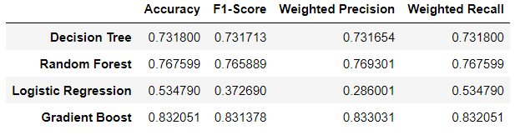

ARREST RESULTS

Slide 47
BEST ARREST RESULT AFTER
GRIDSEARCH & CROSS VALIDATION
83.7%

Slide 48
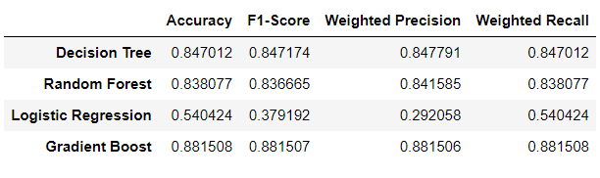
DOMESTIC RESULTS

Slide 49
BEST DOMESTIC RESULT AFTER
GRIDSEARCH & CROSS VALIDATION
88.6%

Slide 50
KAFKA
05.
Building real-time streaming data pipeline

Slide 51
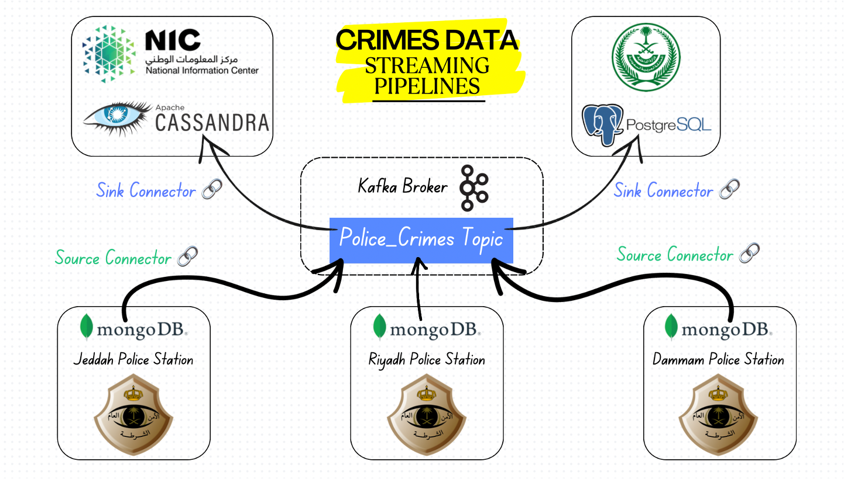

Slide 52
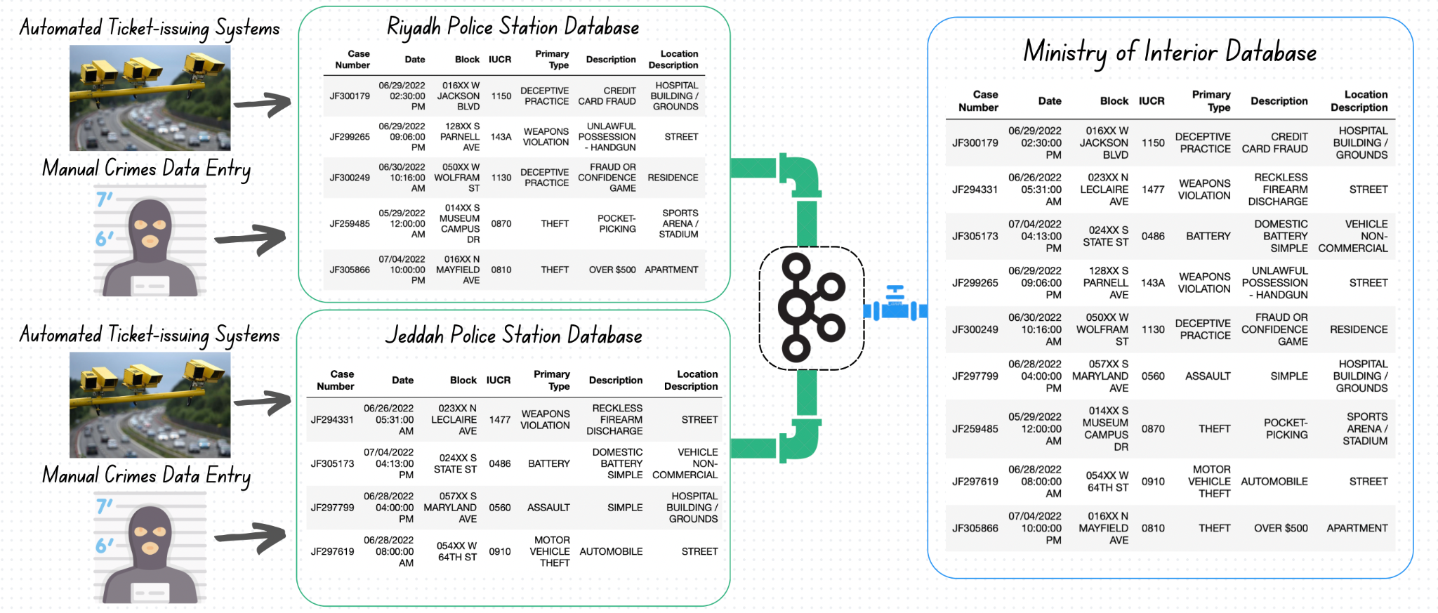

Slide 53
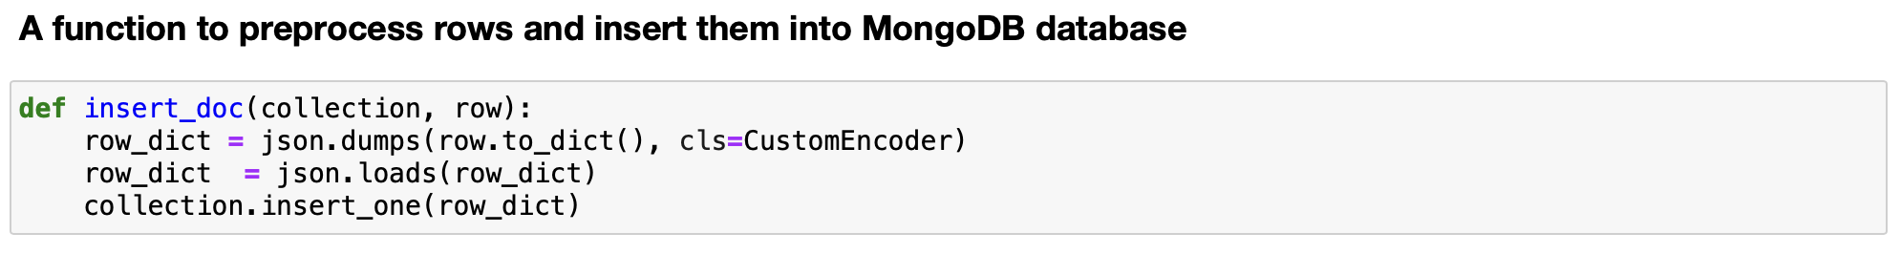
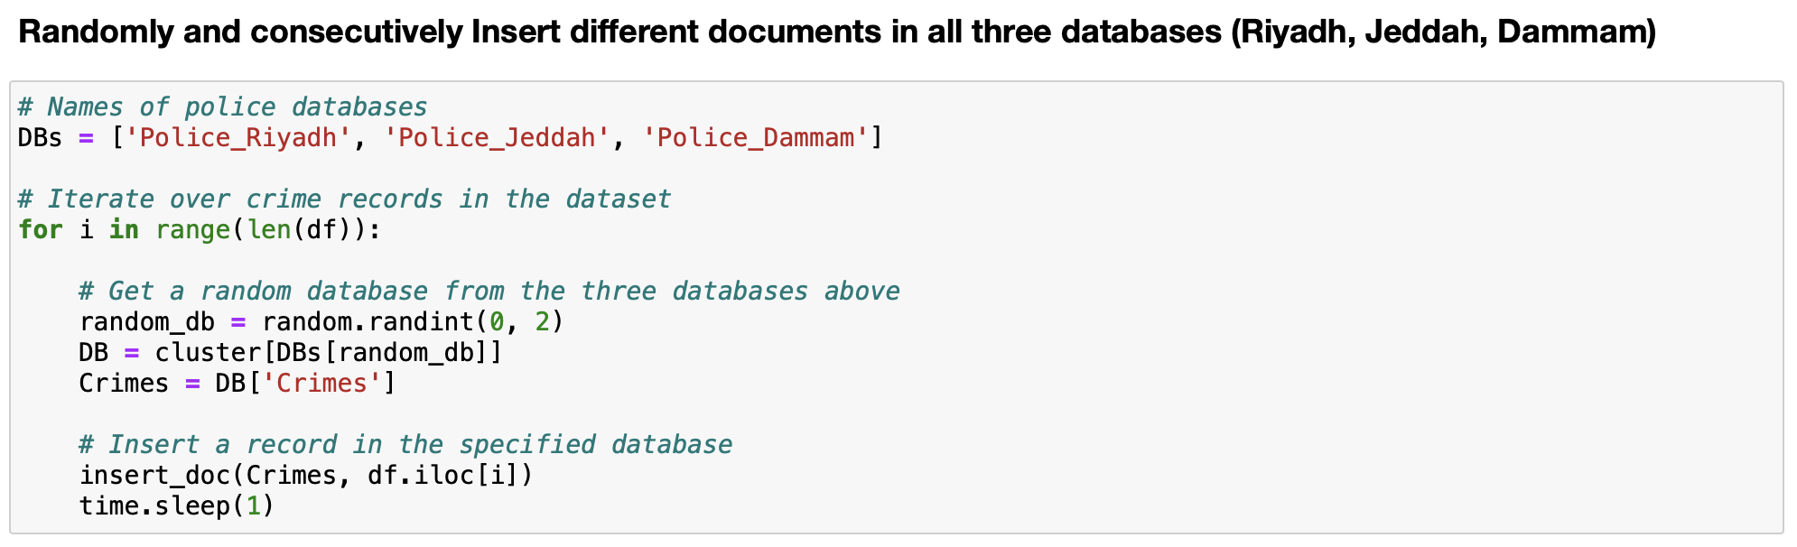
Produce (Ingest data to databases)

Slide 54
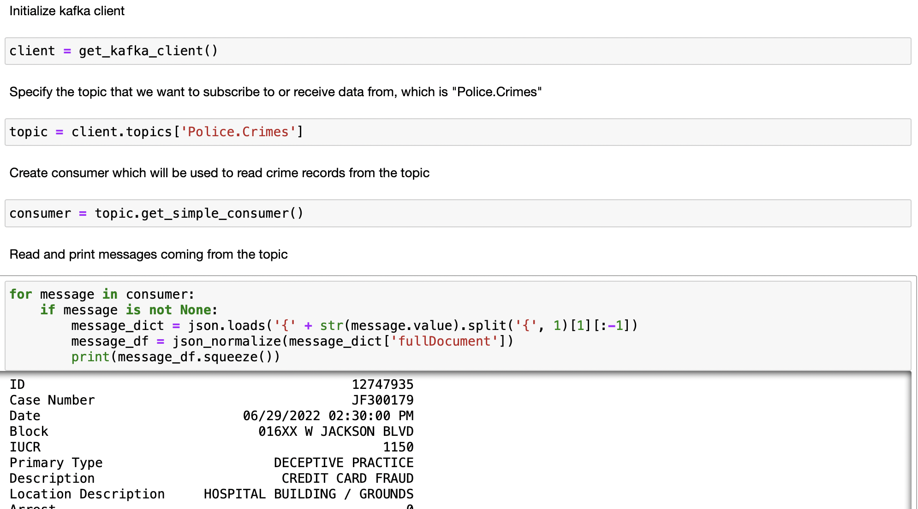
Consume

Slide 55
CONCLUSIONS
06.
Findings and Future work

Slide 56
Future Work
Find and apply ML part on local crimes data.
Connect Kafka with other types of databases (i.e. Cassandra, MySQL, PostgreSQL etc.)

Slide 57
THANKS!
Do you have any questions?

